Slide 1
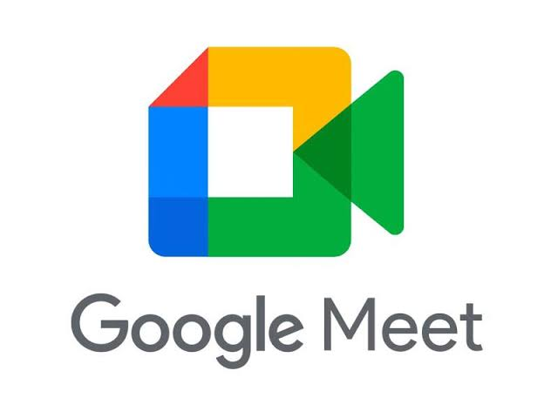

Slide 2
What is Google Meet ?
Google Meet was introduced as an upgrade to the original Hangouts application. Which was introduced 9th of March 2019
Meet grew by a factor of 30 between January and April 2020, with 100 million users a day accessing Meet.
So for Google Meet one can say pendamic was a thing.
In May 2020 , Asus unveiled videoconferencing hardware designed for use with Google Meet in conference room settings.
In March 2020, Google rolled out Meet to personal (free) Google accounts.

Slide 3
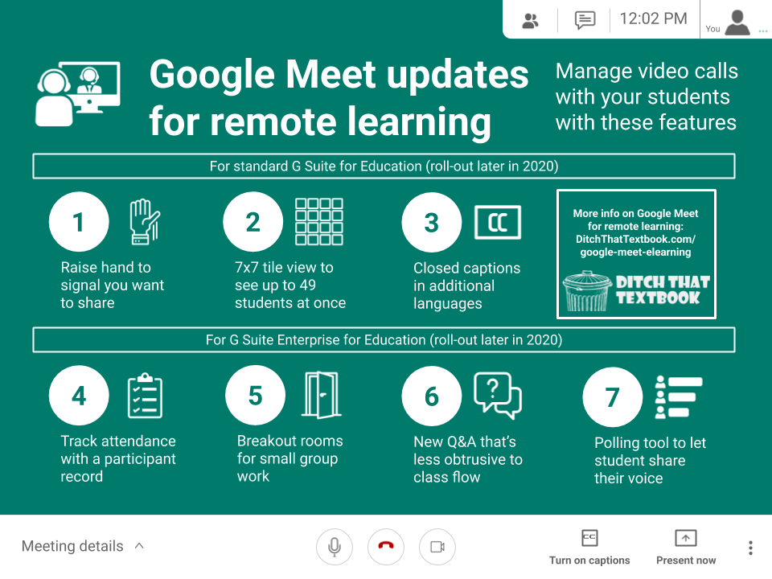
FEATURES :
Two-way and multi-way audio and video calls with a resolution up to 720p
Ability to join meetings through a web browser or through Android or iOS apps
Noise-canceling audio filter.
Screen-sharing to present documents, spreadsheets, presentations, or other browser tabs

Slide 4
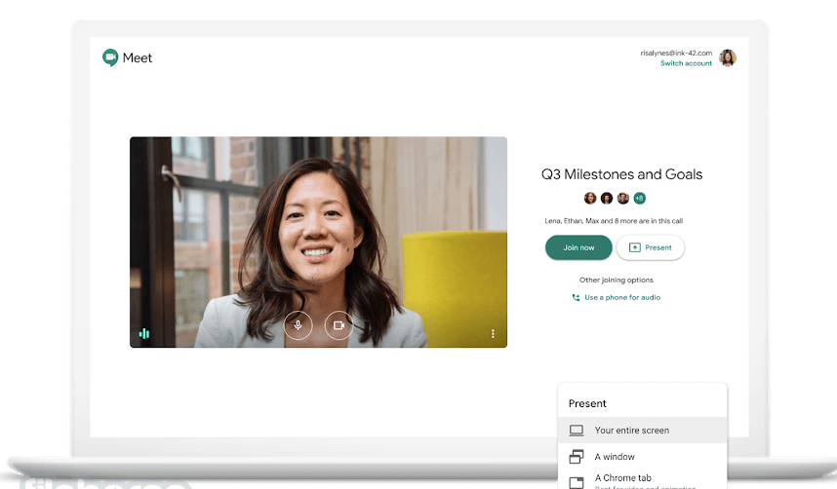
Allowing user
Easy to connect user friendly UI.
Accessible through login across the globe
Option for data saver for people with low data connectivitly

Slide 5
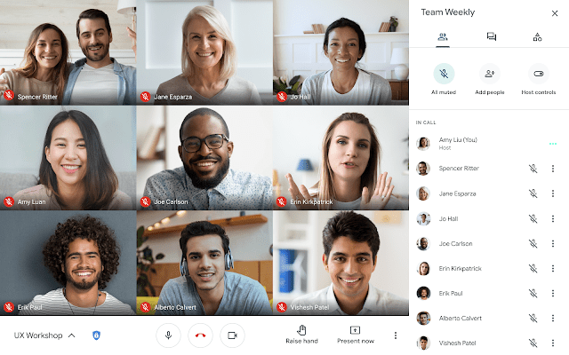
With Google Workspace, you have the ability to include a phone number and PIN
More secure with the ability to ban someone from the meet
Can actually take many more participants for some kind a paid participants
n

Slide 6
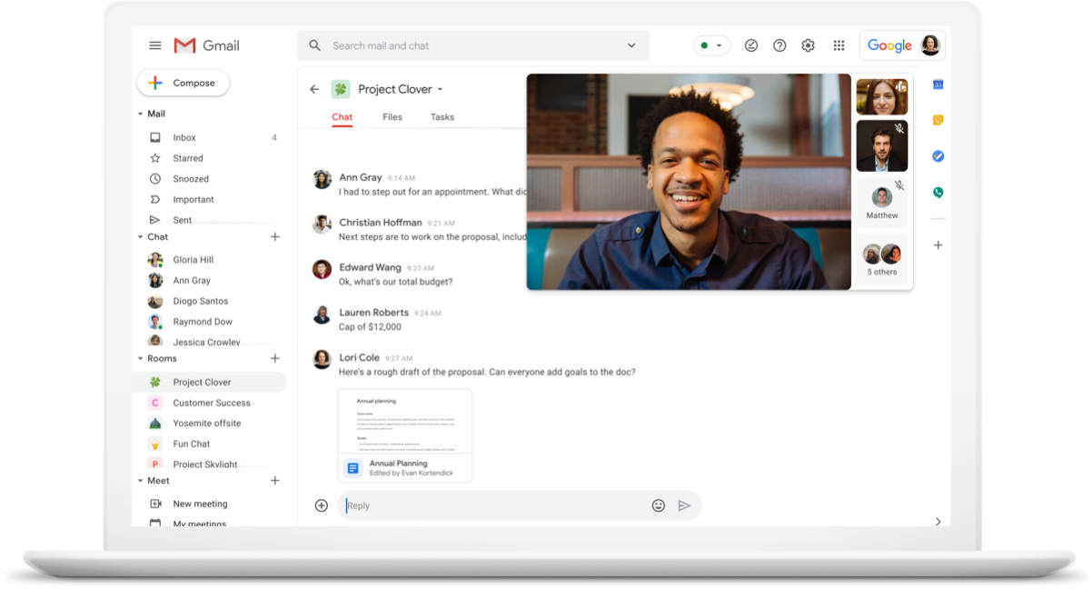
Do I need to install anything?
For users on Chrome, Firefox, Safari and new Edge, we don't require or ask for any plugins or software to be installed, Meet works entirely in the browser.
More than meetings. Meet is fully integrated with Google Workspace.

Slide 7
How does google meet work ?
Google meet is said to an AI based system that is able to make the system more interactive.
Participants in a meet can use in app msg, audio and video chats
Google meet attract people not just school but big organization.
Meets originally was update from hangout app launched by google.

Slide 8

How much meet make?
Google Meet was called “Hangout Meet.” Meet is a component of Google’s G-Suite—a collection of cloud-based productivity apps
G-Suite plans start at $6 a month per user and go all the way to $25 a month per user.
G-suite with the help of google meet has made $19 million dollars across the globe till 2022
The cost of the plan determines how many people can participate in a Meet video conference and security.

Slide 9
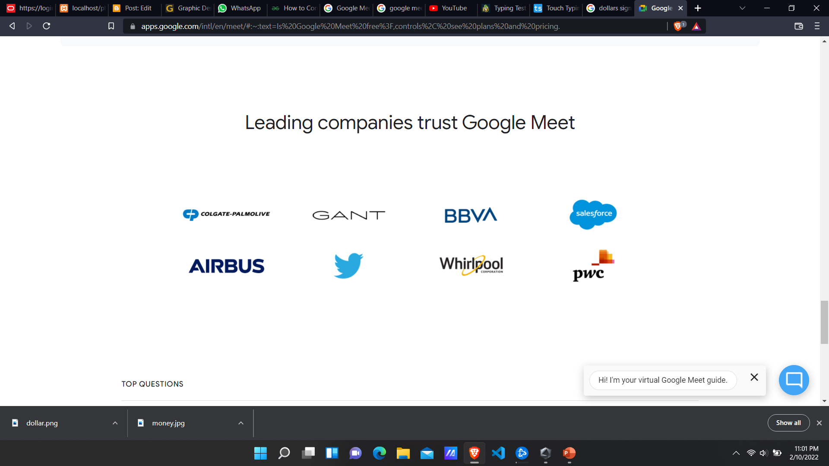
Leading companies trust Google Meet

Slide 10


Thanks for paying
attention

